Slide 1
Implicit Solver for 1-D SWE
Finite Victory Method
Deltares + Computational Science NL Hackathon
June 2025

Slide 2
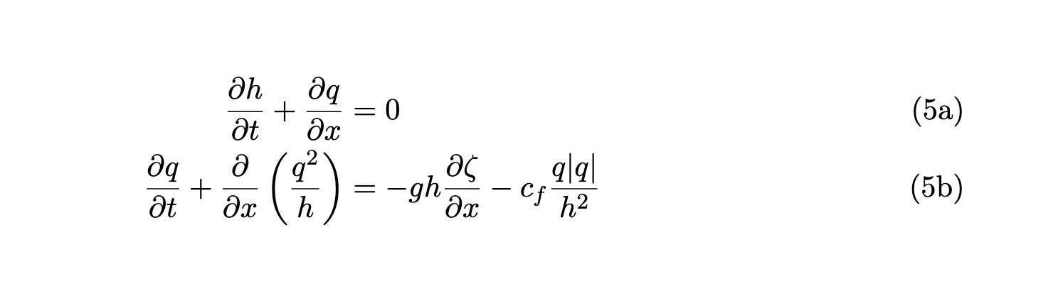
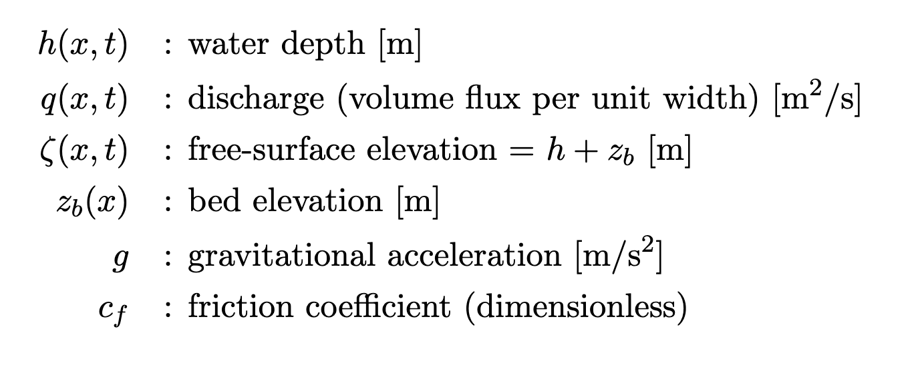
1-D SWE in differential form

Slide 3
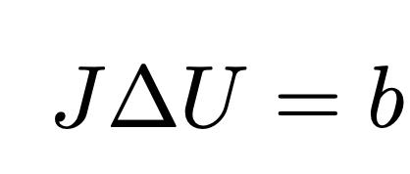
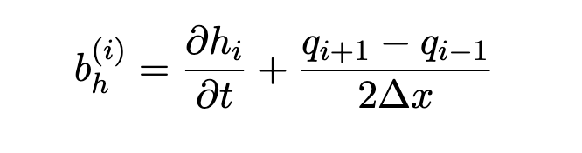

Central differences scheme (2nd order accurate)
Notes:
Why? -

Slide 4
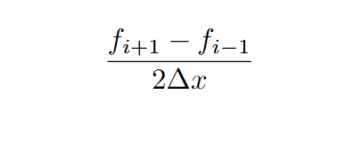
Why use the central difference scheme?
Second-order accurate in space, as required by the challenge.
Simple to implement on a uniform 1D grid.
Uses symmetric stencil: as on the image
Minimizes numerical diffusion and preserves wave shapes.
Efficient: no need for Riemann solvers or flux limiters.
Well-suited for smooth initial conditions like the Gaussian pulse in the test case.

Slide 5
Simulating using c_{f} = 0 (flat ground)

Slide 6
Simulating using c_{f} = 0 (wavy ground)

Slide 7
Simulating using c_{f} = 0.00232 (flat ground)

Slide 8
Simulating using c_{f} = 0.00232 (wavy ground)

Slide 9
Alternative: Dirichlet BC
flat ground
wavy ground

Slide 10
Other things we tried:
Different solvers (Trap + BFD, …)
Using sparse Jacobian matrix to reduce time complexity
Other boundary conditions (Dirichlet+Neumann, GABCs)
Other test conditions (different initial height, different water bed form)

